Slide 1
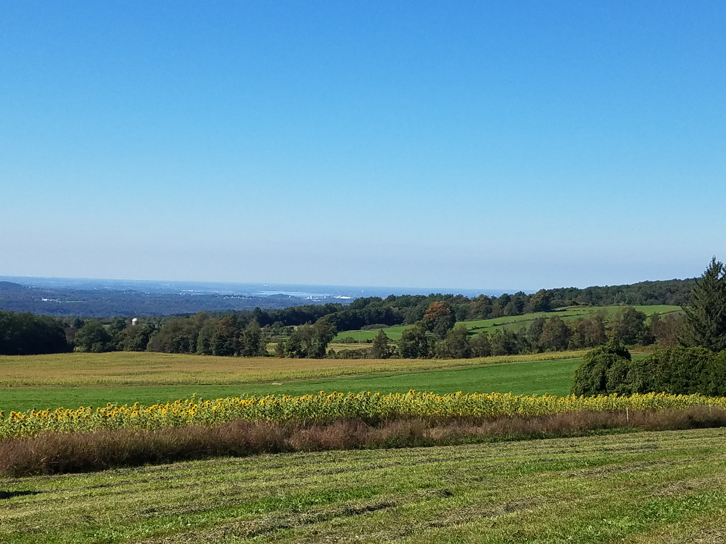

Onondaga County, NY
Multi-Jurisdictional
Hazard Mitigation Plan Update

Slide 2

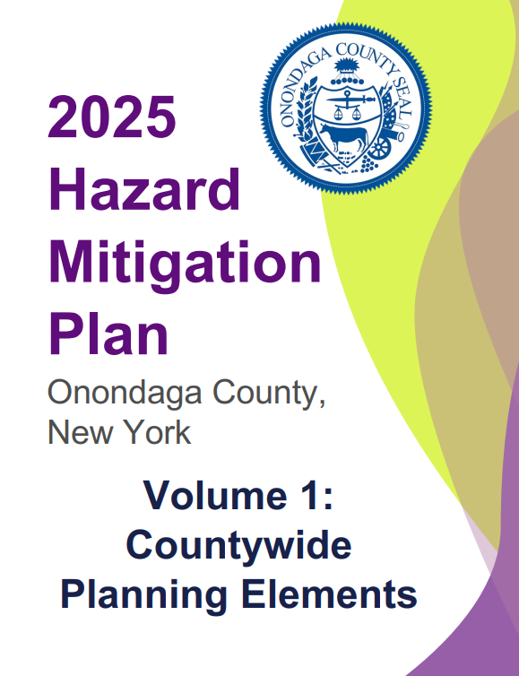
Hazard Mitigation Plan Overview
FEMA Region 2 has approved the Onondaga County Multi-Jurisdictional Hazard Mitigation Plan five year update pending adoption.
The 2025 update includes:
  Volume I – Countywide Planning Area
  Volume II – 36 Jurisdictional Annexes
The Plan was reviewed and approved by the New York Division of Homeland Security and Emergency Services (NYDHSES) and FEMA.
To maintain eligibility for federal hazard mitigation grants, the Plan must be adopted by each plan participant (municipality and special district).

Slide 3
Hazard Mitigation Goals
The hazard mitigation goals represent the County’s long-term strategic vision for achieving successful mitigation efforts.
Goal 1
Protect life, property, and the environment.
Goal 2
Increase understanding and awareness of natural hazard risk.
Goal 3
Promote resiliency throughout the County.
Goal 4
Protect the environment and natural resources.
Goal 5
Promote and support partnerships.
Goal 6
Enhance disaster preparedness, response, and recovery.

Slide 4
Hazards Addressed
Drought
Earthquake
Flood
(riverine, flash/urban, ice jam, dam and levee failure)
Geological Hazards
(landslides, land subsidence, mudboils)
Harmful Algal Bloom
Heat Wave/Extreme Heat (NEW)
Invasive Species and Infestation
(Emerald Ash Borer, Hemlock Woolly Adelgid, True Armyworm, Common Reed (Phragmites), Eurasian Watermilfoil, Water Chestnut, Tick-Borne Diseases, Mosquito-Borne Diseases)
Severe Weather
(thunderstorm, hail, strong winds, tornado, hurricane/tropical storm, nor'easter)
Wildfire (NEW)
Winter Weather
(blizzards, heavy snow, ice storms, cold wave/extreme cold)
This Plan only addresses natural hazards

Slide 5
Countywide Hazard Ranking
Rank | Hazard | Rank | Hazard
1 | Urban/Flash Flood (Flood) | 11 | Tropical Storm/Hurricane (Severe Weather)
2 | Winter Weather (blizzards, lake effect snow, nor’easter, ice storm) | 12 | Dam and Levee Failure (Flood)
3 | Strong Winds/Damaging Winds (Severe Weather) | 13 | Hail (Severe Weather)
4 | Harmful Algal Bloom | 14 | Earthquake
5 | Severe Thunderstorm (Severe Weather) | 15 | Tornado (Severe Weather)
6 | Riverine/Creek/Ice Jam (Flood) | 16 | Wildfire
7 | Invasive Species and Infestation | 17 | Landslide (Geological Hazards)
8 | Cold Wave/Extreme Cold (Winter Weather) | 18 | Land Subsidence (Geological Hazards)
9 | Heat Wave/Extreme Heat | 19 | Mudboils (Geological Hazards)
10 | Drought
Notes:
The hazard risk ranking is an important step in developing a mitigation action plan, as it allows jurisdictions to compare the risk factors from one hazard to another.
That comparison provides critical information to use in selecting hazard mitigation actions and their priorities.

Slide 6
Jurisdictional Hazard Ranking
Rank | Hazard | Rank | Hazard
1 | GO TO SECTION 10 (HAZARD RISK RANKING) OF YOUR ANNEX AND UPDATE THE TABLE IN THIS SLIDE ACCORDINGLY. | 11
2 |  | 12
3 |  | 13
4 |  | 14
5 |  | 15
6 |  | 16
7 |  | 17
8 |  | 18
9 |  | 19
10
Notes:
Each jurisdiction was able to conduct its own hazard ranking.
GO TO SECTION 10 (HAZARD RISK RANKING) OF YOUR ANNEX AND UPDATE THE TABLE IN THIS SLIDE ACCORDINGLY.

Slide 7
Mitigation Actions
Status |  | Mitigation Action Total
Continuous |  | #
In Progress/Not Yet Completed |  | #
No Progress/Not Yet Started |  | #
New |  | #
TOTAL |  | #
Complete |  | #
Discontinued |  | #
Mitigation Actions per Hazard
Drought | # | Harmful Algal Bloom | #
Earthquake | # | Invasive Species and Infestation (Emerald Ash Borer, Hemlock Woolly Adelgid, True Armyworm, Common Reed (Phragmites), Eurasian Watermilfoil, Water Chestnut, Tick-Borne Diseases, Mosquito-Borne Diseases) | #
Heat Wave/Extreme Heat | # | Severe Weather (severe thunderstorms – hail, strong winds/damaging winds, tornadoes, hurricane/tropical storm) | #
Flood (riverine, flash/urban, ice jam, dam and levee failure) | # | Winter Weather (blizzards, heavy snow, ice storms, cold wave/extreme cold, nor’easter) | #
Geological Hazards (landslides, land subsidence, mudboils) | # | Wildfire (wildfire smoke) | #
Each jurisdiction was required to have one (1) mitigation action for each hazard ranked high or medium in the hazard ranking.
These actions were developed in collaboration with other [Enter Jurisdiction Name] departments, agencies, and stakeholders.
Notes:
GO TO SECTION 11 (MITIGATION ACTIONS) OF YOUR ANNEX AND COMPLETE THE TABLE IN THIS SLIDE. IF YOU PREFER TO COPY/PASTE FROM YOUR ANNEX, YOU CAN DO THAT AS WELL!

Slide 8
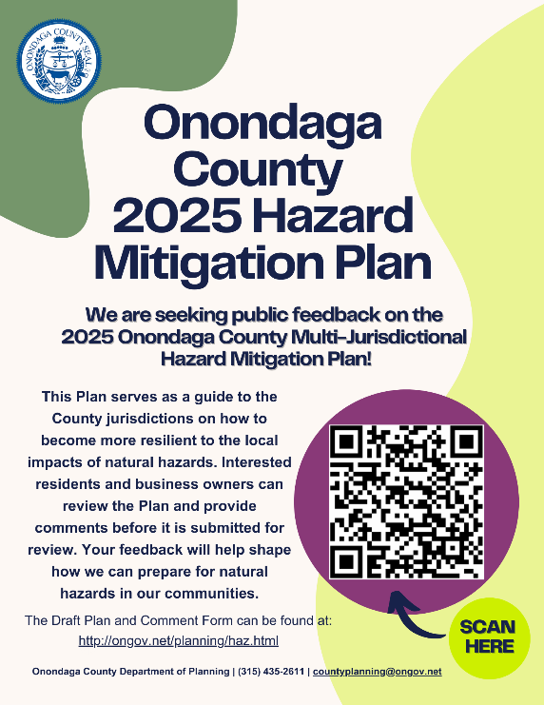
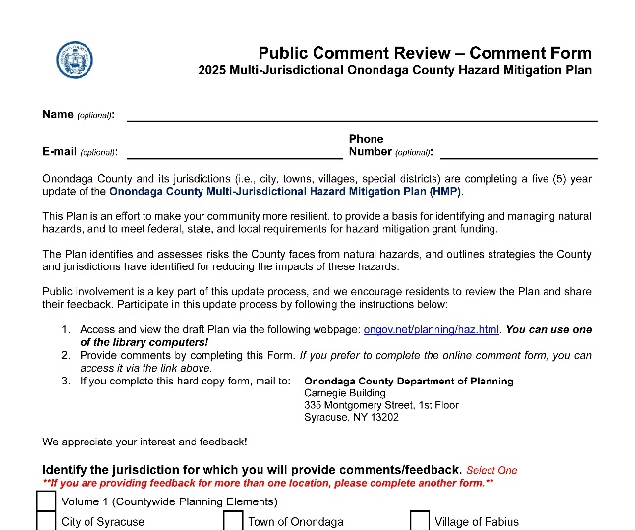
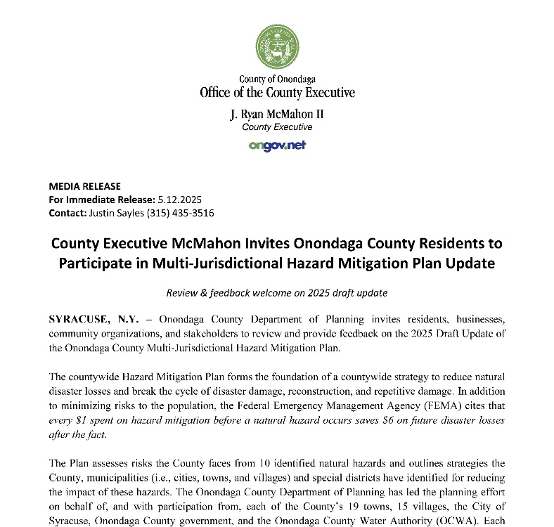
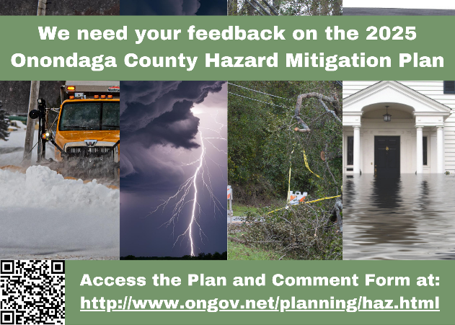
Public Comment Period
Individuals who live and/or work in Onondaga County were provided an opportunity to review and provide feedback on the Plan draft (Volume 1 and all the plan annexes) before the Plan was submitted to the State and FEMA.
Public Comment Period
May 1, 2025 – May 30, 2025
Notes:
An opportunity to be involved in the planning process means that these stakeholders are invited to be engaged or are asked to provide information or input to inform the plan’s content. Different communities may necessitate more targeted outreach and engagement, especially underserved communities.

Slide 9
Plan Update and Review Timeline
March 2023
NYS/OC Contract Executed
November 2022
HMP Grant Awarded
September 2023
OC Legislature Approved Acceptance of Funding
June 2023
Released RFP
Received Two Proposals
November 2023
Consultant (ISC) Selected

Slide 10
Plan Update and Review Timeline
February 2024
Conducted Participant Workshops
June 2024
July 2024
Project Kickoff Meeting
Jurisdictional Letters of Intent
Initial Steering Committee Meeting
Conducted Public Meeting
Complete Revisions to Vol I and Annexes
October 2024 – February2025
Jurisdictions Update Their Annexes
Prepare for Public Comment Period

Slide 11
Plan Update and Review Timeline
Submitted Plan to the NYDHSES
(First Submission)
NYDHSES had 45 days (approximately) to review and provide feedback.
Incorporated State feedback.
Re-Submitted Plan to NYDHSES
(Second Submission)
NYDHSES had an additional 45 days to review.
Once approved by the State, the Plan was sent to FEMA for review and approval.
February 12, 2026
January 7, 2026
July 28, 2025
Public Comment Period
FEMA designated the Onondaga County MJHMP as Approvable Pending Adoption (APA) for all participating jurisdictions.
Incorporated public and stakeholder comments (as applicable).
Finalized MJHMP and Plan Review Tool.
May 2025

Slide 12
Plan Adoption and Implementation
March – May 2026
August 2026
Plan Adoption by All Jurisdictions
Present Updated Plan to Jurisdictions
Next Five Years
Implement and Monitor Mitigation Actions
2029
Begin Next Five Year Update

Slide 13
Next Steps: Plan Adoption
Without adoption, the jurisdiction has not completed the mitigation planning process and will not be eligible for certain FEMA assistance (e.g., HMGP, FMA) for mitigation actions.
Each jurisdiction must adopt the Plan by its governing body to demonstrate the jurisdiction’s commitment to the hazard mitigation goals and actions.
Participating jurisdictions need to adopt the Plan promptly after it is granted APA status to be eligible for certain types of FEMA non-emergency disaster assistance.
Onondaga County’s goal is to have 100% jurisdictional approval by August 31, 2026.

Slide 14
Questions
Onondaga County Department of Planning Team
Jeff Harrop, Planner II
(315) 435-2673
JefferyHarrop@ongov.net
Megan Costa, Assistant Director for Planning
(315) 435-8571
MeganCosta@ongov.net

